Slide 1
Practical Statistics via python – Session 3
Instructor: Rasha Sadeq Abdin

Slide 2
Agenda
Data analysis Process
Visualization via Pandas
Practical Project Demonstration

Slide 3
Data Analysis Process – Ask the right questions
Ask
Prepare
Process
Act
Analyze

Slide 4
Data Analysis Process – Ask the right questions
Example:
Retail store → To identify which product lines are more sold, however they are not more profitbale compared to others
Human Resource Department → Why performance evaluation is better in specific departments comapred to other departments

Slide 5
Data Analysis Process – Ask the right questions
1. Ask Step
Questions to ask yourself in this step:
What are my stakeholders saying their problems are?
Now that I’ve identified the issues, how can I help the stakeholders resolve their questions?

Slide 6
Data Analysis Process – Ask the right questions
Ask Step
What is the problem & what is the client expectation?
Define the problem (there are different problems’ types) or what I am trying to solve from the case.
What is the client expectations, in terms of quality, time, and budget.

Slide 7
Data Analysis Process – Ask the right questions
Ask Step
- Be a domain expert, or at least understand the case on hand and have background
Be careful about stakeholder expectations in terms of timeline, quality, budget.
Understand what data are available, and what are missing and need to be collected to boost your case.

Slide 8
Data Analysis Process – Ask the right questions
2. Prepare
Questions to ask yourself in this step:
What do I need to figure out how to solve this problem?
What research do I need to do?

Slide 9
Data Analysis Process – Ask the right questions
2. Prepare
- Study what data is available
What additional data should be available
Which data resources & research should I be working on ( shall I do meetings with the client, surveys, build on new database)

Slide 10
Data Analysis Process – Ask the right questions
3. Process
Questions to ask yourself in this step:
What data errors or inaccuracies might get in my way of getting the best possible answer to the problem I am trying to solve?
How can I clean my data so the information I have is more consistent?

Slide 11
Data Analysis Process – Ask the right questions
3. Process
- Analyse the data from statistical perspective.
- Apply Describe through pandas. (Compare between mean & 50%, max & 75%) to highlight outliers, the data distribution.
- Apply drop, append & merge.
Drop → for irrevelant features for my case

Slide 12
Data Analysis Process – Ask the right questions
4. Analyse
Questions to ask yourself in this step:
What story is my data telling me?
How will my data help me solve this problem?
Who needs my company’s product or service? What type of person is most likely to use it?

Slide 13
Data Analysis Process – Ask the right questions
4. Analyse (Build on a story)
- Apply additional features to have a story based on my case
Append & merge → for related and correlated features
Sum & mean → to highlight the flow of data
- Apply certain visulizations to understand indepth the case on hand.

Slide 14
Data Analysis Process – Ask the right questions
5. Share
Questions to ask yourself in this step:
How can I make what I present to the stakeholders engaging and easy to understand?
What would help me understand this if I were the listener?

Slide 15
Data Analysis Process – Ask the right questions
5. Share
- Be concise in presenting your case to the top management

Slide 16
Data Analysis Process – Ask the right questions
6. Act
Questions to ask yourself in this step:
How can I use the feedback I received during the share phase (step 5) to actually meet the stakeholder’s needs and expectations?

Slide 17
Data Analysis Process – Ask the right questions
Question 1
In which step of the data analysis process would an analyst ask questions such as, “What data errors might get in the way of my analysis?” or “How can I clean my data so the information I have is consistent?”
Process
Prepare
Analyze
Ask

Slide 18
Visualisation

Slide 19
Data Visualization
Data visualization is the representation of data through use of common graphics, such as charts, plots, infographics, and even animations. These visual displays of information communicate complex data relationships and data-driven insights in a way that is easy to understand

Slide 20
Data Visualization
Why?
Visualization →
Is the best way to present your story to management and stakerholders from different backgrounnds
- To plot and identify the hidden patterns in my data.

Slide 21
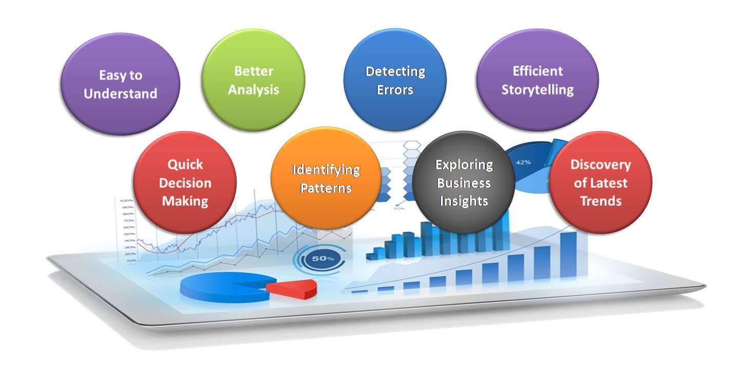
Data Visualization

Slide 22
Data Visualization
Types:
Histogram (Distribution and frequency)
Boxplot (To identify outliers)
Scatterplot (For correlation)
BarPlot (For categorical features)

